Slide 1

ECVCP Annual General Meeting
Arhnem, September 26th 2019

Slide 2
EBVS Updates
Lidewij Wiersma, DipECVP - EBVS CEO

Slide 3
Treasurer’s Report

Slide 4
Contact details
Apologies that I (Tim!) cannot attend the AGM in person
If you have any questions then please email me on ecvcp.treasurer2017@gmail.com
Or I will be at the meeting from Friday onwards so feel free to ask questions to me personally

Slide 5
Current account balances
TSB bank account (£)
  12/10/18 - £22,646
  23/9/19 - £13,619*
Paypal account (€)
  12/10/18 - €19,257
  18/7/19 - €34,616
  * Includes £952 paid by University College Dublin (needs to be refunded)
Notes:
Sterling bank balance has decreased (~£10,000) since last year’s AGM, however this is a deliberate strategy to keep college’s assets in Euros where possible due to current weakness of pound sterling.
Euro Paypal account has increased in value over this time by ~15,000 euros

Slide 6
Incomes 2018
Major incomes 2018 | Euros | Sterling
Membership income | 11,800 | 1,815
Fees for residents, programme/lab accredtn |  | 810
Exam fees | 483 | 1,353
TOTAL | 12,283 | 3,978
 | ~ £15,500
Notes:
This table shows all incomes to the college in 2018

Slide 7
Expenditures 2018
Major expenditure 2018 | Euros | Sterling
Sue Lennon (Secretariat) |  | 5,348
PayPal fees | 236
EBVS |  | 2,734
Exam committee related expenses | 48 | 1,569
Meetings (London ECVCP Board 2017) |  | 600
Meetings (Vienna ECVCP Board 2018) |  | 2,818
Meetings (ZP - EBVS 2018) | 612
ZP Attendance at ACVP 2018 | 1,529
Robert Pluim (Financial consultant) | 400
TOTAL | 2,825 | 13,069
 | ~ £15,600
Notes:
You can see overall that expenditures in 2018 were roughly in line with incomes (£15,600 vs £15,500 income)

Slide 8
Incomes 2019 Year to date (YTD)
Major incomes 2019 | Budget | YTD £ | YTD €
Diplomate fees | £12,500 | 676 | 12,800
Fees for residents, programme/lab accredtn | £500 | 1,446 | 1,000
Exam fees | £1,750 | 2,664 | 250
Summer School registrations (20) | £3,600 | 417 | 4,200
TOTAL | £18,350 | £5,203 | €18,250
 |  | ~ £22,100
Notes:
Incomes are above expected budget in all income areas.
Diplomate income was boosted by payments from Diplomates considered inactive (who were not budgeted for)
Also reasonable income from lab accreditations and new resident registrations (new income stream)
More residents than usual are also enrolled for the exam in 2019
Cathy allowed more than 20 residents to attend the summer school, therefore incomes for this were also higher than expected

Slide 9
Expenditure 2019 YTD
Major expenditure 2019 | Budget | YTD £ | YTD €
Sue Lennon (Secretariat) | £5,000 | 3,795
Paypal fees | £300 |  | 347
EBVS | £2,800 | 2,648
Exam related expenses | £2,500 | 260
Meetings (Vienna Board) | £3,000 | 2,319
Meetings (EBVS) | £1,000 | 660 | 584
Meetings (EL attendance at ACVP) | £0 | 320
Summer School | £3,600 | 3,209
Robert Pluim (Financial consultant) | £400
TOTAL | £18,600 | £16,420 | €931
Notes:
Expenditures for most ‘big ticket’ items are below budget – Summer school was £400 under budget and expenses associated with Vienna Board meeting were also £700 below budget.
Areas for which additional expenditure is expected before the end of 2019 are shown in yellow
A few areas are slightly over budget, one of which was cost of Ernst’s attendance at ACVP, which was not budgeted for. This is now accounted for in the proposed 2020 budget
Overall by end of 2019, I would expect income in 2019 to exceed expenditure by around £3,000.

Slide 10
Predicted year end account balances
TSB bank account (£)
  23/9/19 - £13,619
  End of 2019 ~ £9,267 (vs £28,789 on 1/1/18)
Paypal account (€)
  23/9/19 - €34,616
  End of 2019 ~ €34,216 (vs €7,853 on 1/1/18)
Notes:
Based on predicted expenditures for rest of 2019, I would expect the financial position of the ECVCP to be as shown above
We continue to be in good financial health. Since 1/1/18 I would estimate that the assets of the college have increased by around 5,000 euros.

Slide 11
Current status of diplomates
84 active diplomates
5 payments for 2019 outstanding (was 22 last year!)
Notes:
Most diplomates have paid their fees after a letter was sent by the President, however a few who still have not paid in 2019

Slide 12
Proposed ECVCP 2020 Budget
Major incomes (approx):
Diplomate fees (85) £12,000
Exam fees (4) £1,900
Residency registration (2) £450
Programme Accreditations (2) £900
TOTAL £15,250
Major expenditure (approx):
Secretariat £5,000
EBVS £2,800
Meetings (Board, EBVS and ACVP) £4,500
Exam related £2,500
Financial consultant £400
TOTAL £15,200
Notes:
Looking ahead to 2020, and the possible incomes and expenditures, you can see that incomes and expenditures should be balanced.

Slide 13
Committees’ Reports
Education Committee

Slide 14
Education Committee
No change on list of member
Members list on website:
Maria Elena Gelain (chair),
Inger Lilliehook (until the end of this year)
Ilse Schwendenwein
Hege Brun-Hansen
Bente Kristin Sævik
Barbara Von Beust
Abigail Guija De Arespacochaga
Searching for new member..

Slide 15
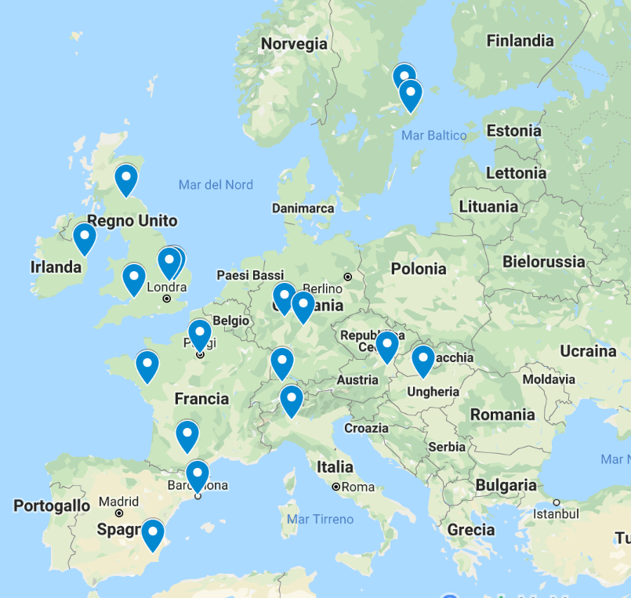
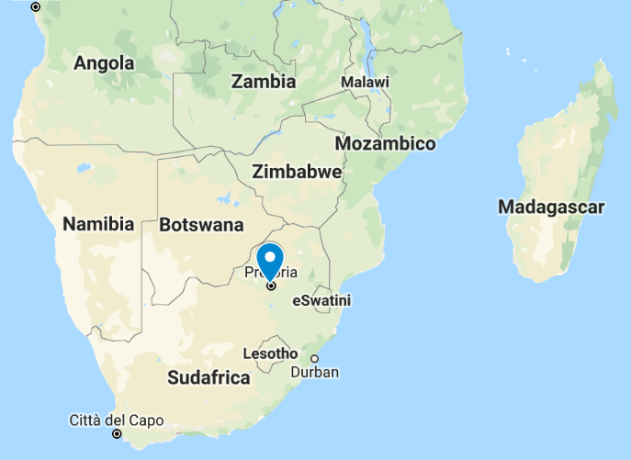
Training program
2018: 16 approved training program:
11 university - 5 commercial lab
  4 TP in UK,
  3 TP in France
  2 TP in Austria, Germany and Sweden
  1 TP in Swiss
  1 TP in Ireland
  1 TP in South Africa
Renewal of Barcelona, Murcia and Milan (university)
NEW training program in Budapest (university) and Milan (Biessea Lab)
2019: 21 approved training program:
15 university – 6 commercial lab
  4 TP in UK,
  3 TP in France
  2 TP each in Spain, Austria, Germany, Sweden, Italy
  1 TP in Hungary
  1 TP in Swiss
  1 TP in Ireland
  1 TP in South Africa
2 TP RENEWAL APPLICATION DUE IN 2019 ( reminder sent in May)

Slide 17
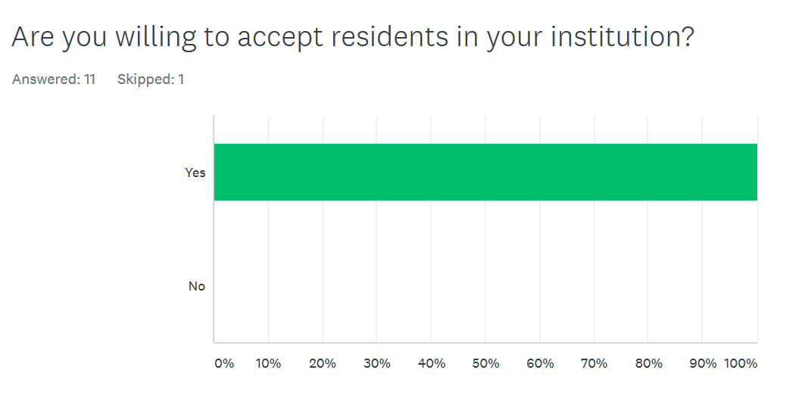
Survey for externships
to facilitate planning of externships
a list of all institutions that offer residency programs and willing to accept residents for short-term visits.
Answered: 12/20

Slide 18
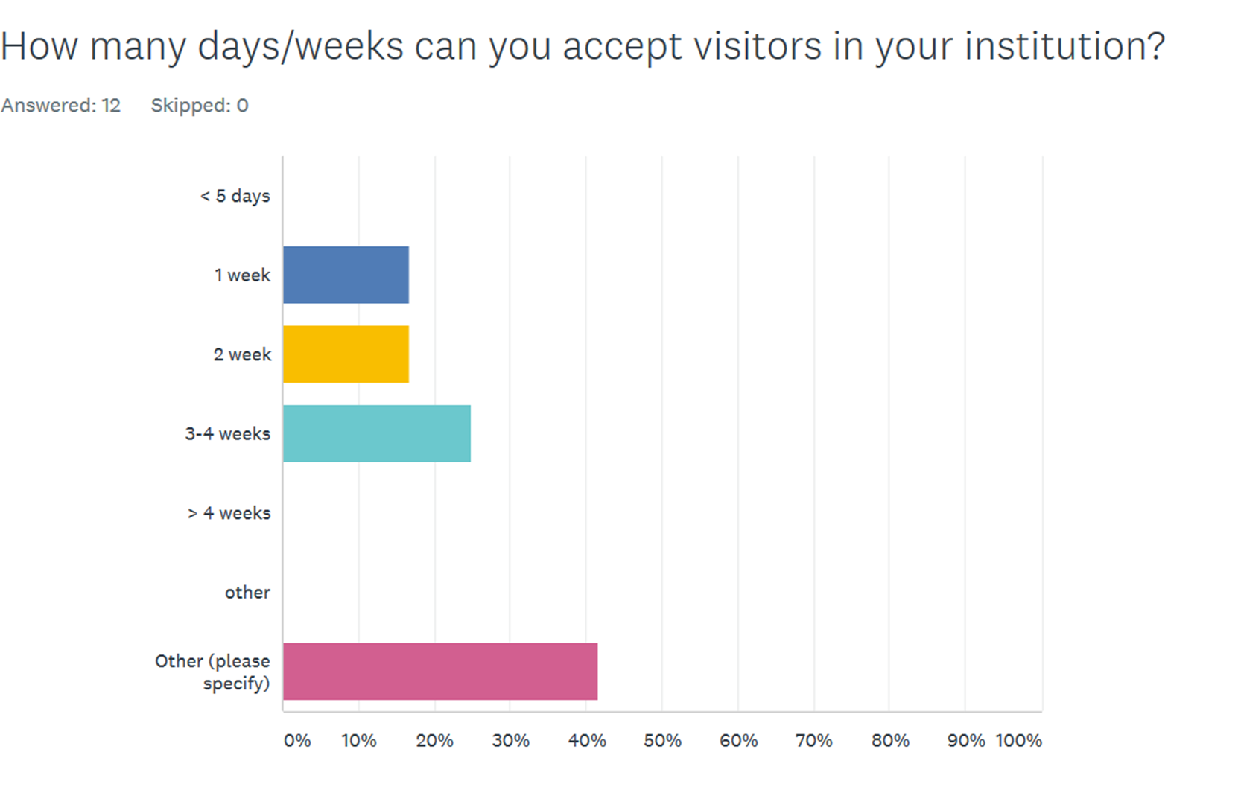
Survey for externships
1 or 2 week

Slide 19
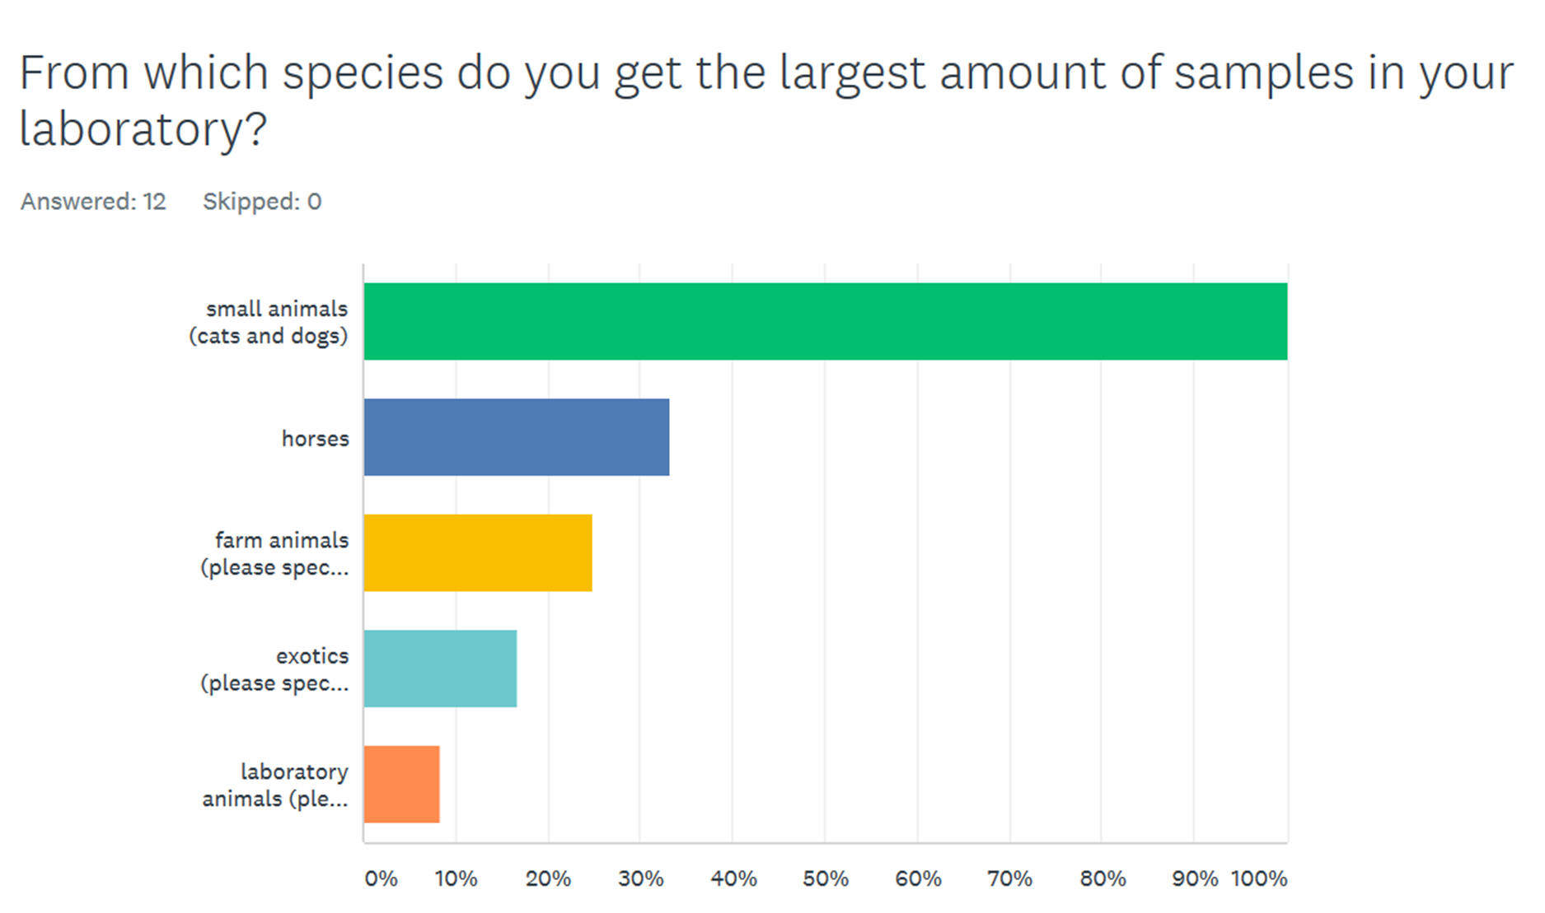
Survey for externships

Slide 20
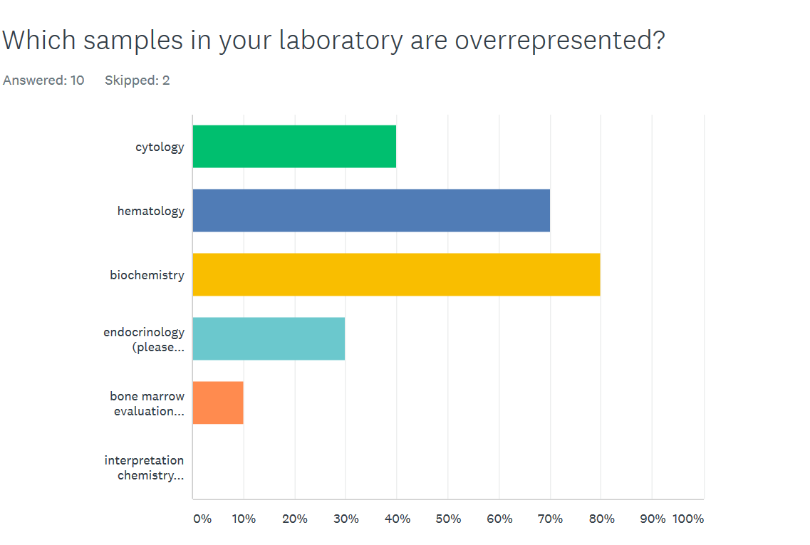
Survey for externships

Slide 21
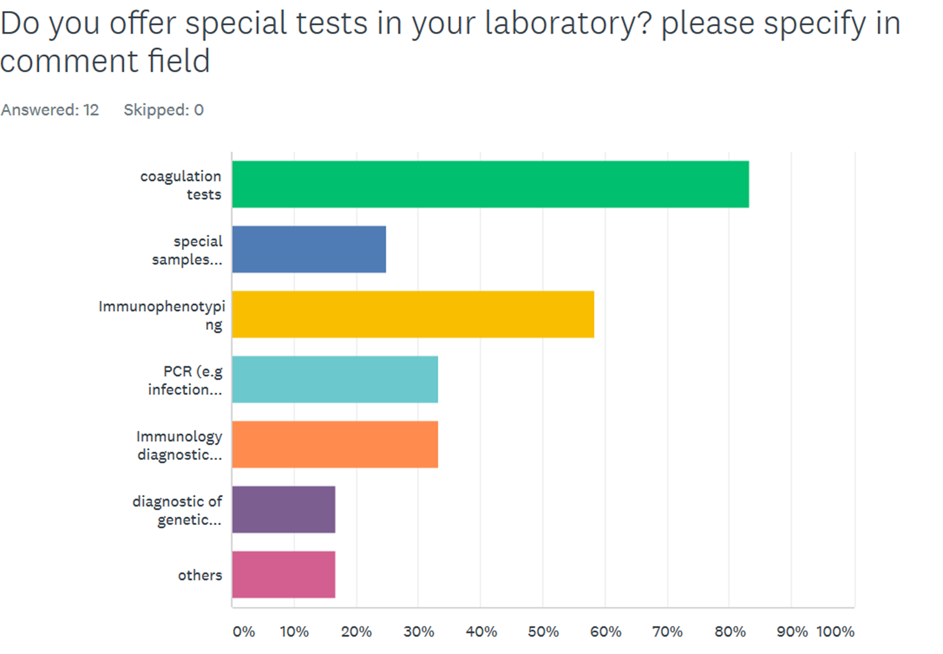
Survey for externships

Slide 22
Survey for externships
We have collected all the information about the single institution
If you need, we can help to identify the lab in which are possible externships in the less common area/species/techniques.
  List of labs with specialties on web site (members only)?
less represented area is the lab animals/toxicology
  Any suggestions on other institutions to be contacted are well accepted
  For those who have not yet answered: survey is still open!

Slide 23
Log-Book
Request from credential com:
wide range of cases, not too much “normal” case o same diseases
Suggestion from credential:
  no logs for normal dog, cat, horse, domestic ruminants (for exotic/ wildlife/ zoo species - maximum of one normal hematology or chemistry per species)
  residents should attempt to include as wide a range of clinicopathological cases
  any deficiencies should be addressed by externships.
  interesting urine chemistry can be logged under chemistry
  interesting urine sediment should be logged under cytology
We’ll work together to help designing a logbook template and explain the why and how.

Slide 24
Committees’ Reports
Credentials Committee

Slide 25
Committee
Erika Furman
Emma Hooijberg (Chair)
Antonio Melendez-Lazo
Mariana Serra
Board liaison: Alessia Giordano

Slide 26
Tasks
Approval of candidates for residency programmes
Annual documentation of residents
Approval of residents for exam admission
Approval of diplomates for reaccreditation
Review credentials of non-ECVCP specialists applying for ECVCP status

Slide 27
Residents
Currently: 20 residents
  5 in 3rd year
  7 in 2nd year
  8 in first year
1 application under review
2 completed residencies (but no 3rd year docs)
Advised of 250 euro fee - Treasurer cc’d in Approval letter

Slide 28
Draper | Alex | RVC, London, UK | Cambridge | Joy Archer | February 2019 | February 2022
Marialigeti | Martin | University of Veterinary Medicine, Budapest | University of Veterinary Medicine, Budapest | Peter Vajdovich | March 2019 | March 2022
Lapsina | Sandra | Latvia University of Life Sciences and Technoloiges | Zurich | Martina Stirn | May 2019 | April 2022
Jensen | Sarah | University of Copenhagen, Denmark | Anicura Bagarmossen, Sweden | Josefine Oberg | May 2019 | April 2022
Castillo | Daniel | Universidad Mayor, Santiago, Chile | Cambridge | Joy Archer | July 2019 | June 2022
Sanchez Redondo | Sonia | School of Veteirnary Science,Leon, Spain | Bristol | Marta Costa | July 2019 | July 2022
Stranieri | Angelica | Department of Veterinary Medicine, Milan | Milan | Saverio Paltrinieri | August 2019 | July 2022
Meazzi | Sara | Department of Veterinary Medicine, Milan | Milan | Alessia Giordano | August 2019 | July 2022

Slide 29
Resident annual logs and supervisor report
Most current residents submitting logs and report on time ☺
About15 per year
Requests were sent for three late submissions - complied

Slide 30
Exam applications
6 new applicants for 2019
All accepted

Slide 31
Currently: 93 active diplomates (excl. honorary/ retired/ officially inactive/associate)
Overdue/ non-active: 12
Due in 2019: 31 – 13 have reaccredited so far
Second reminder was sent end July
2 in progress
PLEASE SEND
  Proof of ESVCP membership
  Proof of exam question acceptance
BY END NOVEMBER
Reaccreditation of diplomates

Slide 32
New scoring system for questions
Present systems
20 Qs compulsory, each Q gets 3 points, max 30 points
New system (2020):
30 points worth of questions compulsory
MCQ 1.5 points
Haem/cyto slide, chem case or GP essay 7.5 points
Max 50 points
So only get points for 10 Qs

Slide 33
Non-ECVCP specialists applying for ECVCP status
Credentials related to training, publications and contributions = to ECVCP exam entrance criteria
Passes exam of same rigor and scope (QA?)
Passes reaccreditation process
Practising in a European country (5 years) and intends to remain so
Status no longer valid if these conditions no longer exist
One application – declined as not in Europe for long enough

Slide 34
SUMMARY SO FAR FOR FOR THIS YEAR
  43 sets of documents reviewed and approved
  1 request for ECVCP recognition for ACVCP diplomate declined
  4 submissions in progress
  17 reaccreditations still to come – BY END NOVEMBER PLEASE!!!
  3 annual resident logs still to approve
  Random questions – please read Info Brochure first
  Please send emails to Secretariat and not private email addresses

Slide 35
Committees’ Reports
Laboratory Standards Committee

Slide 36
Current members LSC
Natali Bauer
Alexandra Briend-Marchal
Margarida Canelas Domingos
Ernst Leidinger
Kathy Freeman
Josep Pastor
Martina Stirn
Stefanie Klenner-Gastreich (chair)
Notes:
No change in LSC members group

Slide 37
Activities 2019
Applications:
  BiEsseA laboratorio IT – inital application
  University of Milan – recertification
Further applications in 2019 to evaluate:
  ...see next slide, marked in green

Slide 38
Currently approved laboratories
12. University of Nantes, F
13. University of Milan, IT
14. University of Pretoria, SA
15. University of Toulouse, F
16. University of Uppsala, S
17. University of Vienna, A
18. University of Zurich, CH
19. VEBIO, F
20. Dick White Referrals, UK
21. Laboklin, D
IDEXX Wetherby, UK
InVitroLab/ IDEXX, A
University of Barcelona, E
University of Bristol, UK
University of Cambridge, UK
University of Dublin, IR
University of Giessen, D
University of Murcia, E
University of Edinburgh, UK
BiEsseA laboratorio, IT
AniCura Stockholm, S
green= recertification due in 2019, red recertification due.
Notes:
Martina, Uni Zurich + Ilse Vienna + Peter Dublin reminded May 25th, 2019
Unclear who is the contact person for IDEXX. IDEXX recertification due in 2018

Slide 39
Plans
Include control of payed LSC fee into SOP and application form

Slide 40
Committees’ Reports
Website Committee
EBVS website
  Advertise yourself
  Photo, short or extended CV
  Current research or business interests

Slide 41
Summer School 2019 aftermath
Summer School Committee
Cathy Trumel
Emma Hooijberg
Maciej Guzera
Antonio Melendez Lazo
Stratos Papakonstantinou

Slide 42
Reciprocity ECVCP – ACVP
Dorothee Bienzle
Anne Provencher

Slide 43
ECVCP Elections 2019
Presentation of the new Executive Board

Slide 44
ECVCP Executive Board 2020-2023
President: E. Leidinger
Vice President: K. Papasouliotis
Secretary: F. Cian
Treasurer: T. Williams
Councillor 1: A. Giordano
Councillor 2: E. Furman

Slide 45
Future ESVCP/ECVCP congresses
Vienna, June 24-27, 2020
Bordeaux, 2021

